Slide 1


Introduction to Ecological Niche Modeling
University of Florida

Slide 2
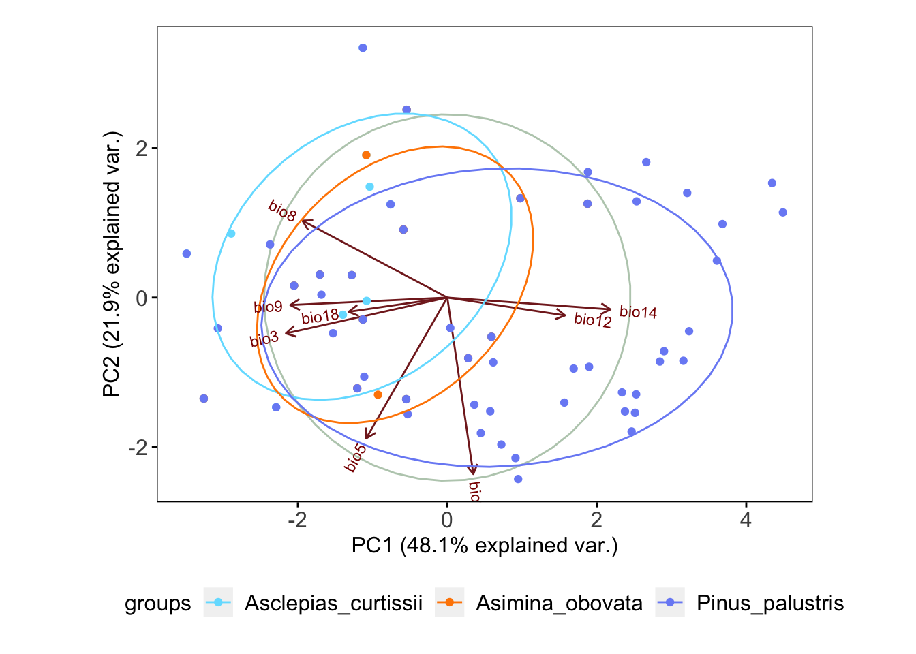
Ecological Niche
Realized Niche
abiotic conditions that a species can occupy with the presence of biotic interactions
Fundamental Niche
abiotic conditions a species could potentially occupy in the absence of biotic interactions

Slide 3
Ecological Niche
Fundamental Niche
abiotic conditions a species could potentially occupy in the absence of biotic interactions
“it is defined in multidimensional ecological space (MacArthur 1972).” – Peterson 2001

Slide 4
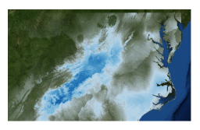
Ecological Niche Modeling
MaxEnt
uses the principle of maximum entropy on presence-only data to predict the species’ potential geographic distribution (or niche)

Slide 5
MaxEnt
MaxEnt used only presence and pseudo-absences for model development
No ”best” algorithm for modeling (Qiao et al. 2015, Methods Ecol Evol), but MaxEnt generally performs well across evaluation criteria (Aguirre-Gutierrez et al. 2013, PLoS One)
What does it do?
Makes prediction for each cell on the landscape.
Models should be chosen that are as similar as possible to prior expectations while also being consistent with the data.
Important notes:
The grids must all have the same geographic bounds and cell size (i.e. all the ascii file headings must match each other perfectly)

Slide 6
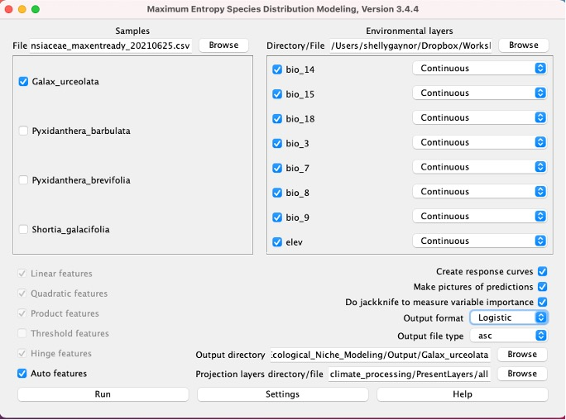
Only one species at a time
Select species specific training layers
Select output directory
Select projection layers

Slide 7
Select logistic

Slide 8
Select logistic
Logistic calculates the conditional probability of occurrence. The probability will be between 0 - 1.

Slide 10
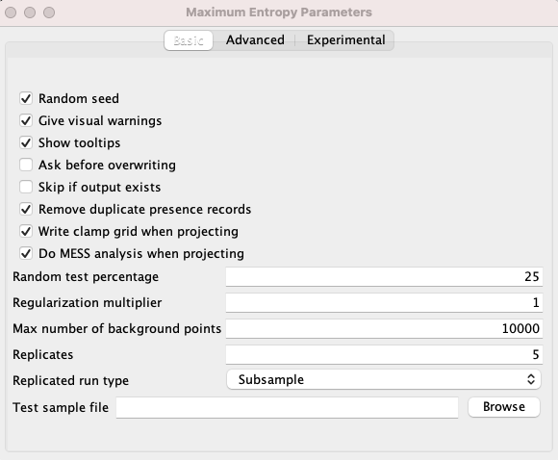
Subsample: in which the presence points are repeatedly split into random training and testing subsets
Bootstrapping: where the training data is selected by sampling with replacement from the presence points
Notes:
Replication!

Slide 11
Notes:
The “25” we entered for “random test percentage” told the program to randomly set aside 25% of the sample records for testing.
This is used to calculate the threshold to make a binary prediction, with suitable conditions predicted above the threshold and unsuitable below

Slide 12
Clamping treats variables outside the training range as if they were at the limit of the training range.
Clamp grid depicted are the absolute difference between predictions with and without clamping.
Notes:
Replication!

Slide 13
MESS = Multivariate Environmental Surface Similarity (MESS)
Notes:
Replication!

Slide 14
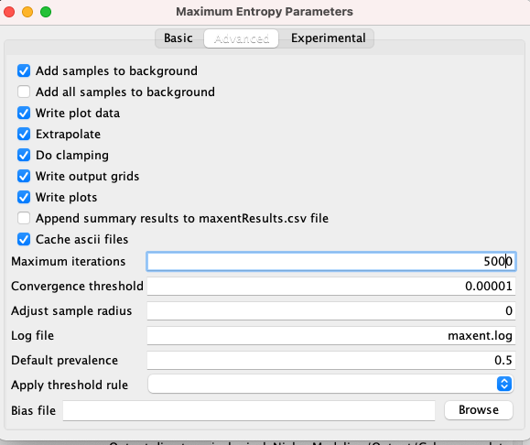
Extrapolate = extent to estimate
Iterations = allows the model to have adequate time for convergence (coming together)

Slide 15
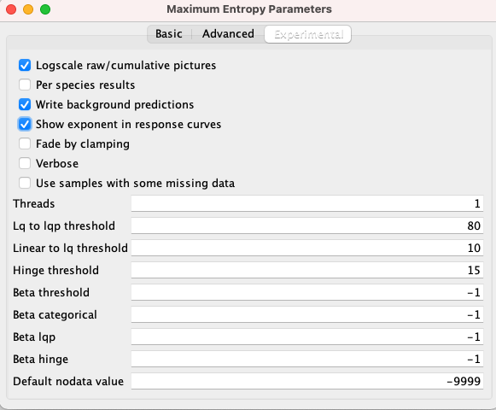

Slide 17
MaxEnt Demo
Files for this activity can be found in “Demo/Manual/Ecological_Niche_Modeling/”
Try out the demo!
After the demo:
R based ENM
Cross-validation and data partitioning
Advance model comparisons
Evaluating ENMs

Slide 18
R based Ecological Niche Models
dismo and ENMeval

Slide 19
ENMeval Improvements
Partitions occurrence and background data into subsets for training and validation
Builds models with different algorithmic settings and evaluates each model

Slide 20
Data Partitioning
partition occurrence localities into testing and training bins (folds) for k-fold cross-validation
Muscarella et al. 2014

Slide 21
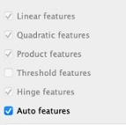
Different algorithmic settings
ENMeval allow the comparison of models with multiple regularization multipliers and different feature classes included
Feature class is used to transform the original predictor
Determines the shape of the marginal responses curve
MaxEnt Feature Classes:
linear (L)
quadratic (Q)
product (P)
threshold (T)
hinge (H)
Determines the penalty associated with including variables or their transformations in the model.
Notes:
Feature class is the method used to transform the original predictor value
feature classes determine the potential shape of the marginal response curves.
regularization multiplier (RM) determines the penalty associated with including variables or their transformations in the model.

Slide 22
Different algorithmic settings
ENMeval allow the comparison of models with multiple regularization multipliers and different feature classes included
Determines the penalty associated with including variables or their transformations in the model.
If set to 0, all feature classes and variables are included: this could lead to overfitting
If set too high, the model could be underfit
Notes:
Feature class is the method used to transform the original predictor value
feature classes determine the potential shape of the marginal response curves.
regularization multiplier (RM) determines the penalty associated with including variables or their transformations in the model.

Slide 23
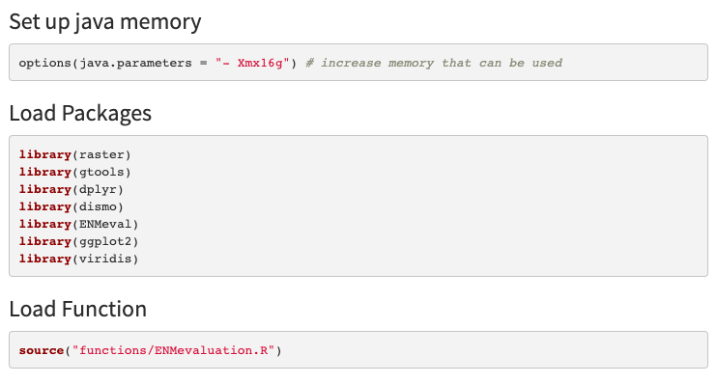
Load Packages, Functions, & Java

Slide 24
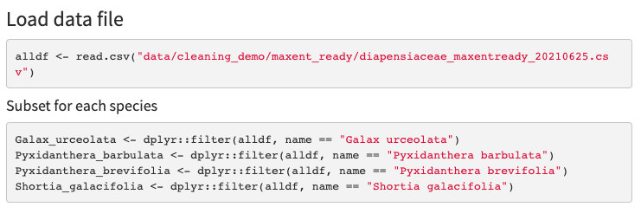
Load Data Files

Slide 25
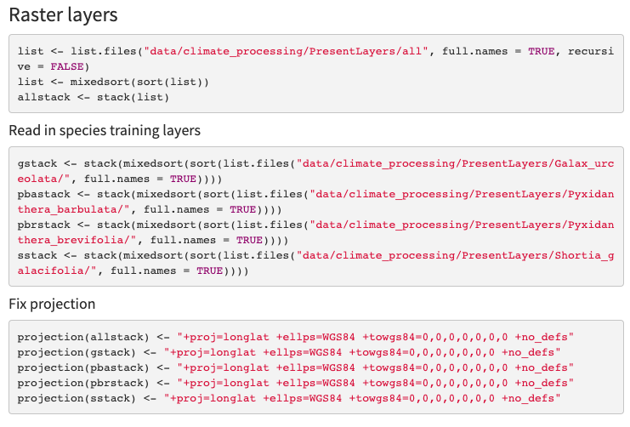
Load Raster Layers

Slide 26
Load Raster Layers

Slide 27
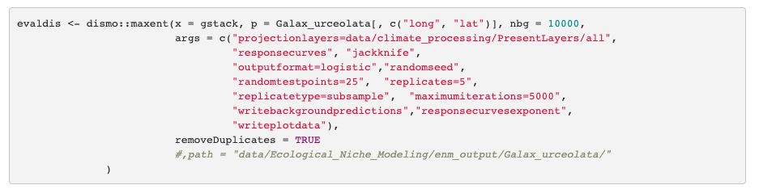
dismo Model

Slide 28
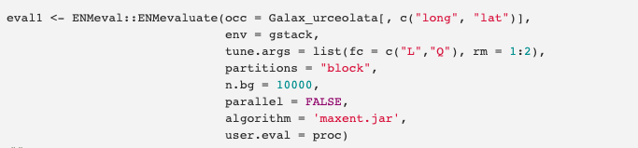
ENMeval Model
For publication worthy comparisons – test more feature-class combinations and a larger range of regularization multipliers:
Ex.: fc = c(“L”, “H”, “LQ”, “LHQ”, “LQP”), rm = c(0.5, 1.0, 1.5, 2.0, 2.5, 3.0, 3.5, 4.0)
For example, see: Wang et al. 2021. Potential distributional shifts in North America of allelopathic invasive plant species under climate change models. Plant Diversity.

Slide 29
Continued in
Interpreting ENMs

